Slide 1

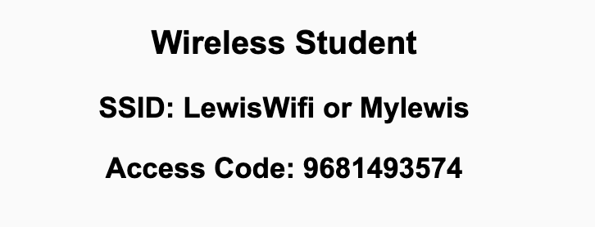
Preflight Check List
Sign into our Zoom meeting through our integrated Blackboard/Zoom link
Make sure that you can hear the conversation, see shared desktops, and view chat topics
Thank you if you choose to leave your camera on to help make our class more interactive
Be prepared to share your computer screen
Be prepared to utilize a headset with a microphone
In person participants also:
Make sure that your microphone and speakers are muted/off so that we don’t get an echo
Sit in a good spot near the classroom ceiling microphones if possible

Slide 2
Recordings
Discuss that recording are:
Opportunistic
Automatically available in Blackboard/Zoom
Sound Check… plus Video, and Desktop Sharing… check
Load Polls… check
Start Recording

Slide 3
Software Engineering
Eric Pogue

Slide 4
Agenda:
Welcome!
Friendly Conversation Topic & Polling
Prework and Announcements
Introductions – Part 1
Sprint 1 Planning
Prework for Next Class
Introductions – Part 2
Discussion & Questions welcome at any time but please be present with no phones or email during our time together

Slide 5
Welcome!

Slide 6
Friendly Conversation Topic
What is a Friendly Conversation Topic?
It’s a topic that is not directly related to course topics but a topic that is relevant, current, and hopefully interesting.

Slide 7
Friendly Conversation Topic – Team Communication Tools
What is your preferred small team communication tool?
Do you have a Discord account?
What has been your experience with Discord?

Slide 8
Prework & Announcements
Welcome Message
Blended Learning
Scrum

Slide 9
Polling

Slide 10
Class Format
Our class is a synchronous in-person class:
Synchronous vs Asynchronous
In-person vs Remote
My expectation is that you will be here in person Tuesdays and Thursdays. If you need to be remote, we understand but please be appreciative of your scrum teammates.
It is important that you attend Sprint Planning and Sprint Retrospectives in-person. Please contact me if you will not be able to be there in-person for these events.
Priorities:
Health and safety
Effective teaming and association
Intended course schedule

Slide 11
Class Format - Exceptions
We have at least one student who will be participating fully remote. Should we have one all remote Scrum team?

Slide 12
Introductions

Slide 13
Foreshadowing Your Introductions
In part 2 of our Instructions you should be prepared to:
Share your preferred name, full name
Share your seat number
Estimate your current programming experience in Python, Java, and Web development where:
1 being “This is my first college level programming class”
3 being “I’ve had a couple of programming classes”
5 being “I’m ready to graduate and get and entry level programming job”
Share an interesting or unique fact about yourself
Provide the best “adjective / noun” Scrum Team name you can come up with… this can be original, one from the following slide, or you can even “pass” on this one if you want
Notes:
Hand out name tags and introduction forms before Syllabus Overview

Slide 14
Scrum Team Names
Scrum team names from previous semesters:
EZScrumEZGo
SourPatchEngineers
DreamRaccoons
TeamFun
SwagMoney
MonaLisas
Scrumdiddlyumptious
FightingBass
TitanicSwimTeam
GloriousKenobis
RedDragons
ScrumciousCoders
Mongooses
Scrumples
WubbaLubbaDubDubs
RedPandas
SpiderScrum
MadSanitizers
SpeedCoders
StingyTadpoles
BlueThrees
PurpleCobras
ScruptyDupty
LaughableCaterpillars
PurplePirates
ScrumIsFum
ScrummyScrumbags
TheCrew
WickedCrew
SpicyChalupa
ScrumOfTheEarth
LightningMcQueen
Notes:
Hand out name tags and introduction forms before Syllabus Overview

Slide 15
Introductions – Part 1

Slide 16
Introductions
Full and Preferred Name:
Eric Pogue
Eric, Mr. Pogue, or Professor
Family, Home, College background:
Married with five children, relocated from Davenport, IA to Chicago area
Undergraduate in CS and Masters in Business… teaching evenings for many years
Programming experience:
Decades in the industry as a developer, architect, project manager, division manager, and vice president of various software development organizations
Part of many teams that have delivered products to ten’s of millions of customers globally
Parsons Technology, Intuit, The Learning Company, Jasc Software, and John Deere
… and most recently working on a startup product “Stadia” with my oldest son
Second year teaching full-time

Slide 17


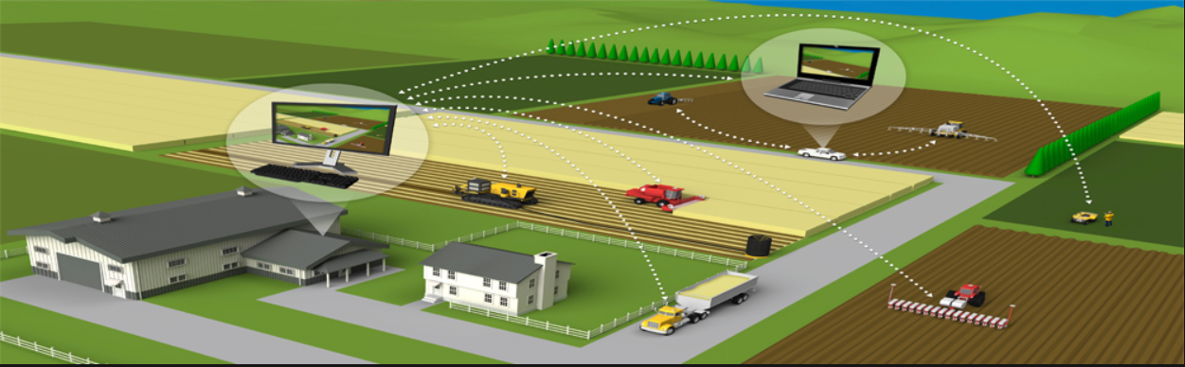





Slide 18
Introductions
Likely programming environment
MacOS, Terminal, Visual Studio Code, and Chrome/Firefox web browser
Top two or three things that you would like to get out of this class
To learn something myself while helping each of you be successful
Motivate you to look deeper while we are exploring technologies and processes
Help you build something that makes you proud
Hobbies:
Wilderness Canoeing & Camping (Quetico) and Triathlons
Fun Fact:
At one point I had the very dubious “honor” or being the most traveled John Deere employee to India with 40+ trips over a 5-6 year period while setting up the 400+ person John Deere Technology Center – India Software Development organization.
Notes:
Vanity

Slide 19


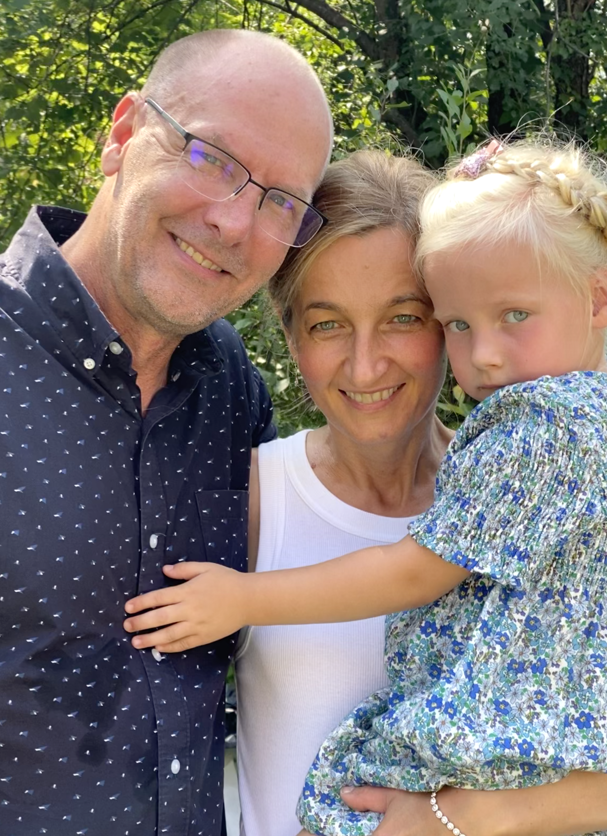
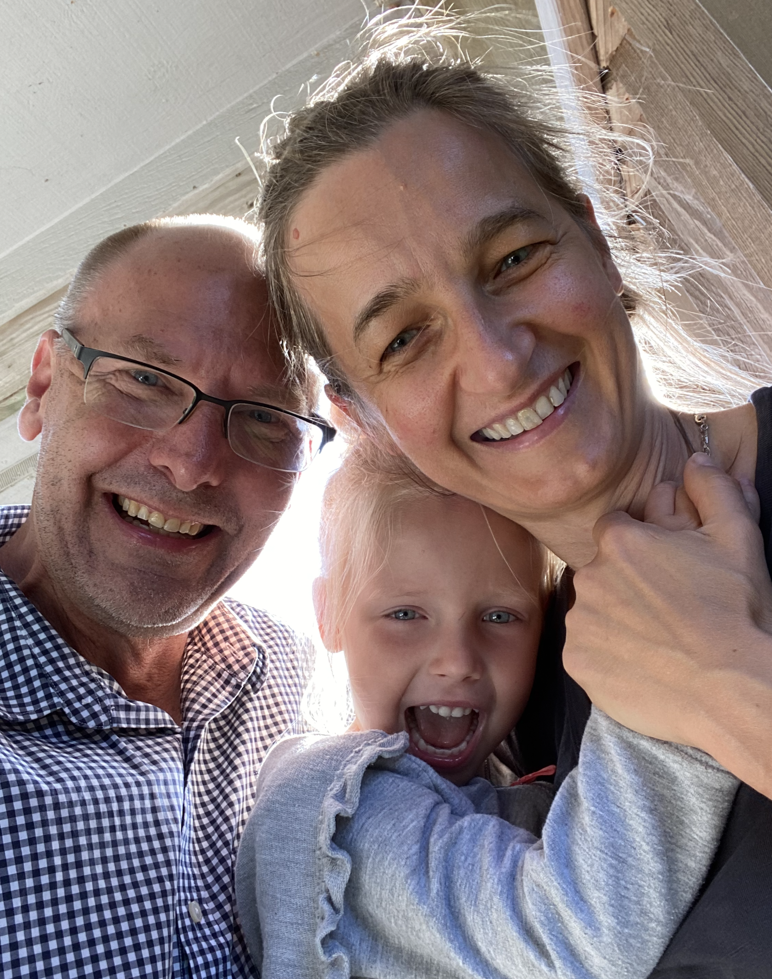
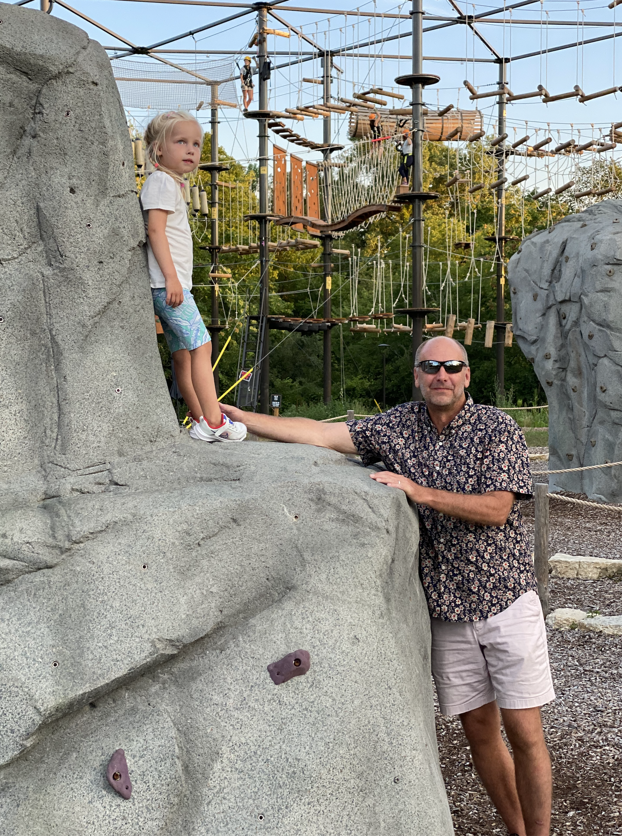


Slide 20
Foreshadowing Your Introductions
In part 2 of our Instructions you should be prepared to:
Share your preferred name… Eric, Professor, or Mr. Pogue
Estimate your current programming experience in Python, Java, Web, or other development:
Python – 3
Java, Go – 4
C++, C, Web/React – 5
Share an interesting or unique fact about yourself… 40+ trips to India
Provide the best “adjective / noun” Scrum Team name you can come up with… SpicyChalupas
Pick an existing or start a new a scrum team… I do wish I could be part of one of the Scrum Teams
Notes:
Hand out name tags and introduction forms before Syllabus Overview

Slide 21
Sprint Planning

Slide 22
Sprint Planning
We will be doing sprint planning at the beginning of each of our 8 sprints during the semester.
Starting in sprint 4 you will be performing sprint planning for your scrum team.
What’s different about Sprint 1 planning?
Next Monday is a Holiday which should not impact us in any significant way

Slide 23
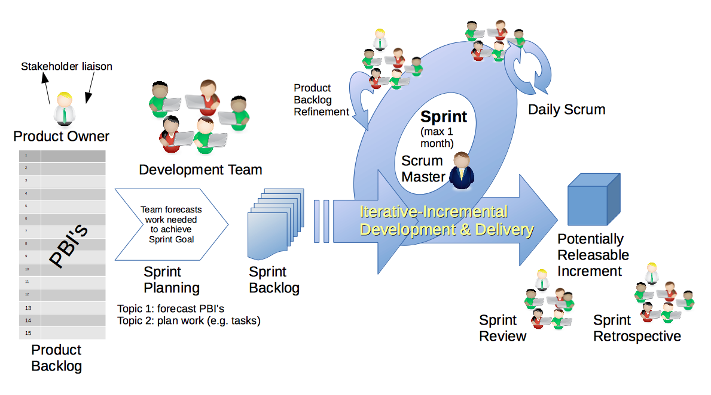
Scrum Process – Sprint Planning
By Dr ian mitchell - Own work, CC BY-SA 4.0, Link

Slide 24
Review Activities List,
Assignments, and Syllabus

Slide 25
Prework For Next Class
Prior to our next class please:
Complete through activity 9 prior to next class
Get your headset with microphone for teaming and programming together activities
Be ready to test your scrum team discussion capabilities with your team Discord server*
Be prepared for your first Scrum Team chapter review which will be on Fox chapter 1 which may require you to use you Discord server to communicate
* You may choose a different communication tool if the team agrees.

Slide 26



Headset Options
What would I recommend?
Airpods or Comparable Sennheiser
Maybe Gaming
Headphones?

Slide 27
Your Introductions

Slide 28
Scrum Team Names
Scrum team names from previous semesters:
EZScrumEZGo
SourPatchEngineers
DreamRaccoons
TeamFun
SwagMoney
MonaLisas
Scrumdiddlyumptious
FightingBass
TitanicSwimTeam
GloriousKenobis
RedDragons
ScrumciousCoders
Mongooses
Scrumples
WubbaLubbaDubDubs
RedPandas
SpiderScrum
MadSanitizers
SpeedCoders
StingyTadpoles
BlueThrees
PurpleCobras
ScruptyDupty
LaughableCaterpillars
PurplePirates
ScrumIsFum
ScrummyScrumbags
TheCrew
WickedCrew
SpicyChalupa
ScrumOfTheEarth
LightningMcQueen
Notes:
Hand out name tags and introduction forms before Syllabus Overview

Slide 29
Your Introductions
In part 2 of our Instructions you should be prepared to:
Share your preferred name, full name
Share your seat number
Estimate your current programming experience in Python, Java, and Web development where:
1 being “This is my first college level programming class”
3 being “I’ve had a couple of programming classes”
5 being “I’m ready to graduate and get and entry level programming job”
Share an interesting or unique fact about yourself
Provide the best “adjective / noun” Scrum Team name you can come up with… this can be original, one from the following slide, or you can even “pass” on this one if you want
Notes:
Hand out name tags and introduction forms before Syllabus Overview

Slide 30
Final Questions?

Slide 31
End of Session

